Slide 1
C Programming Language

Slide 2
What is C?
When C Developed?
Why C?
How it Runs?
Who are all Using?
?

Slide 3
Introduction:
Mother language
General purpose language
Mid-level programming language
It is a procedure and structure oriented language.
It has the full support of various operating systems and hardware platforms.

Slide 4

Introduction:
C was developed in 1972 by Dennis Ritchie at bell laboratories of AT&T (American Telephone & Telegraph), located in the U.S.A.
C language was developed to be used in UNIX operating system.
It inherits many features of previous languages such as B and BCPL.
‘C’ contains 32 keywords.

Slide 5
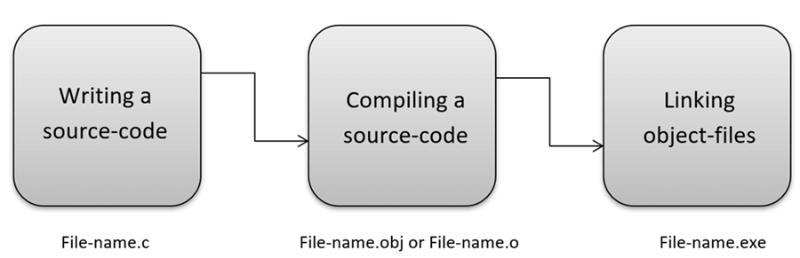
How it Runs:

Slide 6
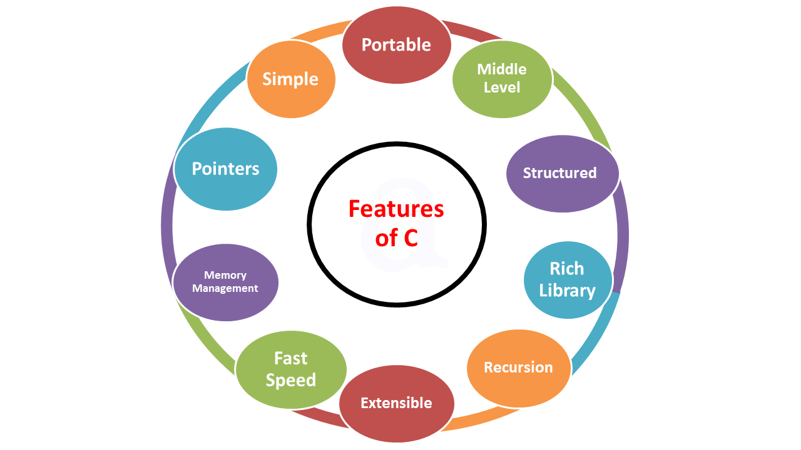

Slide 7
Applications:
It is widely used for developing desktop applications like kernel, driver.
Most of the applications by Adobe are developed using ‘C’ programming language.
It is used for developing browsers and their extensions.
It is used for developing desktop as well as mobile phone’s OS.
Operating systems such as Apple’s OS X, Microsoft’s Windows are developed using ‘C’ language.
It is used for compiler production like mingw and Text Editors.

Slide 8
Printf function
The printf() function is used for output.
This is inbuilt library function, defined in stdio.h (header file).
Syntax:
printf(“Printing Statement”);
printf("format string", argument_list);
Example:
#include<stdio.h>
void main() {
printf(“Hello world”);
}
Note: To run C program we need to install mingw compiler

Slide 9
User Input:
The scanf() function is used for input.
This is inbuilt library functions, defined in stdio.h (header file).
It reads the input data from the console.
Syntax:
scanf("format string", argument_list);
The format string can be,
%d (integer)
%c (character),
%s (string),
%f (float) etc.
Note: To get input from terminal we need to tick RUN IN TERMINAL checkbox in settings

Slide 10
Variables:
A variable is an identifier which is used to store some value inside memory space.
Naming Rule:
A variable name must be meaningful.
only characters, digits and an underscore are allowed.
It should not begin with a number, not consist of whitespace and keyword.
‘C’ is a case sensitive language that means a variable named ‘age’ and ‘AGE’ are different.

Slide 11
Types of Variables:
local variable → inside the block code it will execute
global variable → outside the block of code and scope of execute across entire program.
static variable → Static Variables retain the declared value throughout the entire execution of the program and will not be changed between multiple function calls.
automatic variable → the variables declared in C language are Automatic Variables. (Default)
external variable → We can share a variable in multiple C source files by using an external variable

Slide 12
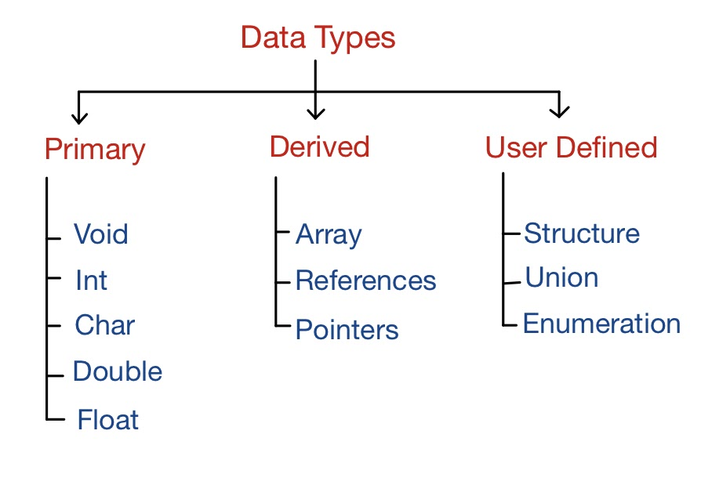
Data types:
Type of data with storage capacity is called Data Type.

Slide 13
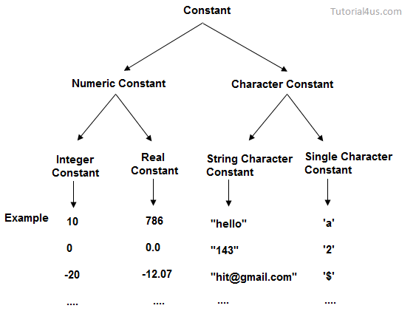
Constants:
Constants are the fixed values that never change during the execution of a program.

Slide 14
Examples:
By Const Keyword:
#include <stdio.h>
int main() {
const double PI = 3.14;
printf("%f", PI);
return 0;
}
By using #define keyword:
#include <stdio.h>
#define PI 3.14
int main() {
printf("%f", PI);
return 0;
}
#DEFINE is a Preprocessor that is also used to declare constant value

Slide 15
Literals:
Literals are data used for representing fixed values.
They can be used directly in the code like 1, 2.5, 'c' etc.
Comments:
It’s a hints that a programmer can add to make their code easier to read and understand.
There are two ways to add comments in C:
// - Single Line Comment
/*...*/ - Multi-line Comment

Slide 16
Storage class:
A storage class represents the visibility and a location of a variable.
It is used to describe the following things:
The variable scope.
The location where the variable will be stored.
The initialized value of a variable.
A lifetime of a variable.
Who can access a variable?
Thus a storage class is used to represent the information about a variable.

Slide 17
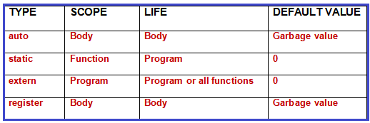
Types of Storage class:
Auto - It is a default storage class.
Extern - It is a global variable.

Slide 18
Static storage class:
It can be used as a global variable
Static global variables are global variables visible only to the file in which it is declared.
Register storage class:
You can use the register storage class when you want to store local variables within functions or blocks in CPU registers instead of RAM to have quick access to these variables.

Slide 19
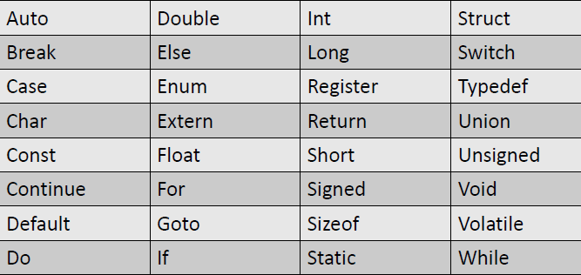
32 Keywords present in c:

Slide 20
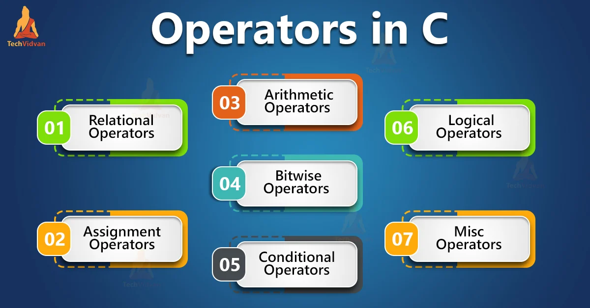
Operators
A symbol which can do some action or performance is called operators.

Slide 21
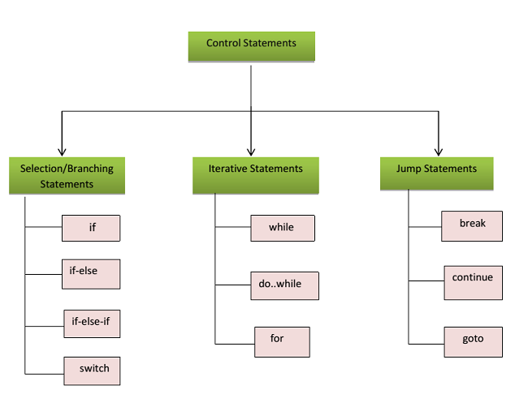

Slide 22
Conditional branching:
If – else Condition:
Syntax:
If(Condition)
{
//Statements;
}
else
{
//Statements;
}
If Condition:
Syntax:
if(Condition)
{
//statement;
}

Slide 23
Switch:
To Choose an Options.
Syntax:
switch(option) {
case 1: //statement;
Break;
case 2:
//statement; default:
//statement;
}
Else-if Ladder:
Syntax:
if(condition) {
//Statement;
}
else if(condition) {
//statement;
}
else {
//statement;
}

Slide 24
Conditional Looping:
1. for(initializer; condition; increment/decrement) {
//statement;
}
2. while(condition) {
//statement;
increment;
}
Do
{
//statement;
increment;
}while(condition);

Slide 25
Jumping statement:
Break:
To stop the flow the program.
Continue:
To skip the particular value in the flow of program.
Goto:
To jump in any statement which is refered.
Return:
To return a data in function to function call.

Slide 26
Functions:
A Function can be defined as a subdivided program of the main program enclosed within flower brackets.
Advantages of Functions:
Writing the same code repeatedly in a program will be avoided.
Functions can be called any number of times in a program.
Tracking a C program easily when it is divided into multiple functions.
Reusability is the main achievement of C functions.

Slide 27
Types of functions:
Library Functions → printf ,scanf
User-Defined Functions→ sum,swap
4 Aspects of using Functions in C Programming:
Function without arguments and without return value
Function without arguments and with the return value
Function with arguments and without return value
Function with arguments and with the return value

Slide 28
Array:
An array is defined as the collection of similar type of data items stored at contiguous memory locations.
The array is the simplest data structure where each data element can be randomly accessed by using its index number.
Syntax:
datatype arrayName[array size];
Example:
int a[5]={1,2,3,4,5};

Slide 29
Types of Arrays:
One-Dimensional Array
an array with a single row and multiple columns
int arrayone[3]={1,2,3};
Two-Dimensional Array→
2D the collection of rows and columns
int arraytwo[2][2 ]={{1,2},{3,4}};
Three-Dimensional Array
3D as the collection of multiple rows and columns
int arraythree[2][2][2] = ]={{1,2},{3,4},{5,6},{7,8}};

Slide 30
String:
The string can be defined as the one-dimensional array of characters terminated by a null ('\0’).
The character array or the string is used to manipulate text.
Each character in the array occupies one byte of memory, and the last character must always be 0.
There are two ways to declare a string in c language.
By char array:
char ch[6]={'h', 'e', ‘l’, 'l', ‘o’, ‘\0’}
By string literal:
char ch[6]="hello";

Slide 31
String functions:
Gets(), puts() → scanf, printf.
strlen(string_name) → returns the length of string name.
strrev(string) → returns reverse string.
strlwr(string) → returns string characters in lowercase.
strupr(string) → returns string characters in uppercase.
strcpy(destination, source) → copies the contents of source string to destination string.
strcat(first_string, second string) → concats or joins first string with second string. The result of the string is stored in first string.
strcmp(first_string, second_string) → compares the first string with second string. If both strings are same, it returns 0.

Slide 32
Pointers:
The pointer in C language is a variable which stores the address of another variable.
This variable can be of type int, char, array, function, or any other pointer.
The size of the pointer depends on the architecture.
However, in 32-bit architecture the size of a pointer is 2 byte.
Example:
int n = 10;
int *p = &n;

Slide 33

Pointer to pointer
a pointer to store the address of another pointer is known as a double pointer (pointer to pointer).
The first pointer is used to store the address of a variable whereas the second pointer is used to store the address of the first pointer.
Example:
int a = 10;
int *p;
int **pp;
*p = &a;
**pp = &p;
PP
P
A

Slide 34
Structure
Structure in c is a user-defined data type that enables us to store the collection of different data types.
Each element of a structure is called a member.
The ,struct keyword is used to define the structure.
We can access the struct by declaring variable.
Syntax:
struct structure_name {
data_type member1; …
data_type memeberN;
};
struct structure_name variable;

Slide 35
Union
Union can be defined as a user-defined data type which is a collection of different variables of different data types in the same memory location.
The union can also be defined as many members, but only one member can contain a value at a particular point in time.
Union is a user-defined data type, but unlike structures, they share the same memory location.
Syntax:
union numbers {
int a;
char b;
}var;

Slide 36
Enum:
The enum in C is also known as the enumerated type.
It is a user-defined data type that consists of integer values, and it provides meaningful names to these values.
The use of enum in C makes the program easy to understand and maintain.
The enum is defined by using the enum keyword.
Syntax:
enum fruits {
mango=10,
apple=5,
strawberry=3,
} ;

Slide 37
typedef
The typedef is a keyword used in C programming to provide some meaningful names to the already existing variable in the C program.
we can say that this keyword is used to redefine the name of an already existing variable.
Example:
typedef int arr[5];
arr a={1,2,3,4,5};
for(int i=0; i<5; i++) {
printf("Value of a[%d] is :%d", I , a[i]);
}

Slide 38
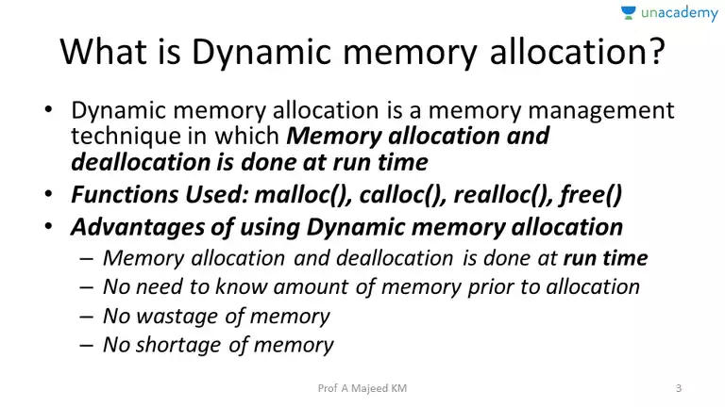
Dynamic memory:

Slide 39
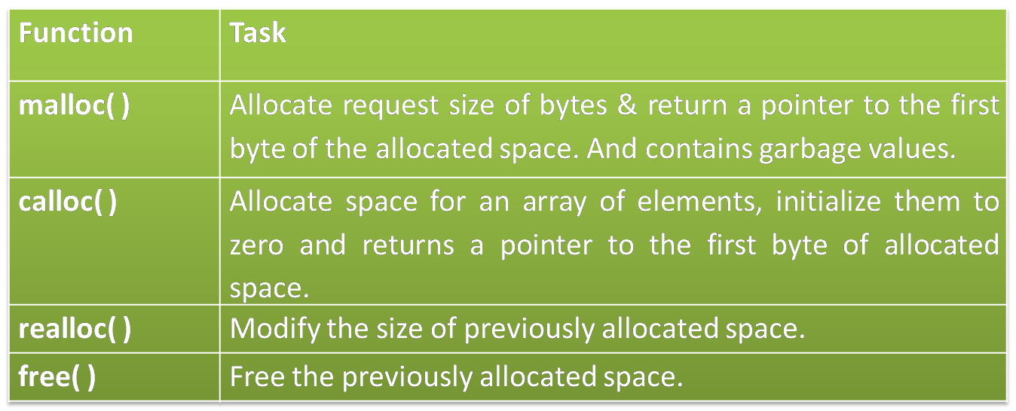
Types:

Slide 40
Error handling:
C language does not provide any direct support for error handling.
However a few methods and variables defined in error.h header file can be used to point out error using the return statement in a function.
In C language, a function returns -1 or NULL value in case of any error and a global variable errno is set with the error code.
So the return value can be used to check error while programming.
Errno:
Whenever a function call is made in C language, a variable named errno is associated with it.
It is a global variable, which can be used to identify which type of error was encountered while function execution, based on its value.

Slide 41
errno valueError
Operation not permitted
No such file or directory
No such process
Interrupted system call
I/O error
No such device or address
Argument list too long
Exec format error
Bad file number

Slide 42
File I/o:
File handling in C enables us to create, update, read, and delete the files stored on the local file system through our C program.
Function Operation
fopen() To Open a file
fclose() To Close a file
fgets() To Read a file
fprintf() To Write into a File
fscanf() reads data from the file
fputc() writes a character into the file

Slide 43
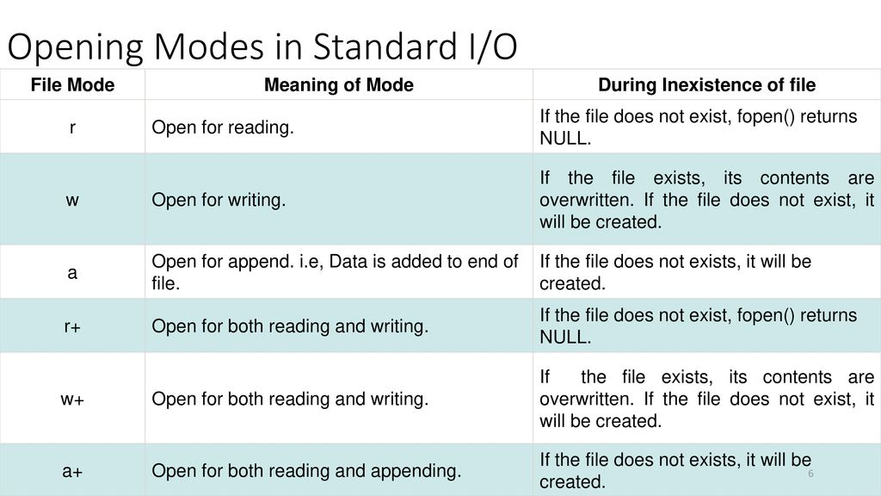

Slide 44
Example:
#include<stdio.h>
void main( ) {
FILE *fp ;
char ch ;
fp = fopen("file.c","r") ;
while ( 1 ) {
ch = fgetc ( fp ) ;
if ( ch == EOF )
break ;
printf("%c",ch) ;
}
fclose (fp ) ;
}

Slide 45
fscanf() & Fprintf()
FILE *fp;
fp = fopen("file.txt", "w");
fprintf(fp, "Hello file");
fclose(fp);
char buff[255];
fp = fopen("file.txt", "r");
while(fscanf(fp, "%s", buff)!=EOF){
printf("%s ", buff );
}
fclose(fp);
}

Slide 46
Preprocesssor
In C programming, preprocessing is the first step in the compilation of a C code.
The preprocessor statements in C are called directives.
A preprocessor section of the program always appears at the top of the C code.
Example:
#define MAX_ARRAY_LENGTH 20;
Note: This #define directive tells the C to replace the instances of MAX_ARRAY_LENGTH with 20.

Slide 47
Directive | Description
# define | Substitutes a preprocessor macro.
#include | Inserts a particular header from another file.
#ifdef | Returns true if this macro is defined.
#ifndef | Returns true if this macro is not defined.
#if | Tests if a compile time condition is true.
#else | The alternative for #if.
#elif | #else and #if in one statement.
#endif | Ends preprocessor conditional.
#error | Prints error message on stderr.

Slide 48
End

